Slide 1
Crisis Decision Making for Nuclear Leaders
Notes:
[Display this slide during the opening remarks and Practical Exercise, Part 1.]
LEGEND FOR SPEAKER NOTES:
[In Brackets: Instructions]
Regular text: Guidance for what to say
*: Click for slide animation. Every asterisk is a click.
Note that some animations play automatically without an additional click.
?: Question to ask to promote discussion
=: Example responses
ALL CAPS: SPECIAL NOTES
NOTE THAT IN PRESENTER VIEW, BOLD AND ITALICS DO NOT SHOW.

Slide 2
Learning Objectives
Terminal objective:
Given your role as an
emergency responder,
understand and apply tools that support
effective decision making
under crisis conditions
as described in the generic advanced FLEX course and in this course.
HANDOUT 1: Learning Objectives
Notes:
[Distribute HANDOUT 1: Learning Objectives]
[Read and elaborate as needed.]

Slide 3
Learning Objectives
Enabling objectives:
Define stress and describe its effects on the brain and body.
Describe how stress resilience and tolerance affect your ability to perform under stress.
Apply tools for recognizing, checking and controlling the effects of stress for yourself and others.
Contrast rational and intuitive decision-making methods and their applications.
Discuss methods that support effective decision making during crisis conditions.
Describe the influences of emotions on leading during a crisis.
In a simulated nuclear plant crisis event, apply methods for decision making under stress using the concepts and methods presented in this course.
HANDOUT 1: Learning Objectives
Notes:
Specifically, the enabling objectives of this course are:
[Read and elaborate as needed.]

Slide 4
Practical Exercise
Part 1
Notes:
BEFORE EXERCISE:
[Direct participants to take their places at the Practical Exercise boards.]
[Remind them to bring a pen, note paper, and reading glasses as needed.]
AFTER EXERCISE:
[Continue the After-Action Review with the following questions:]
?: How did this exercise feel?
=: Stressful, confusing, frustrating, boring, fun
?: Did you feel stress of any kind?
?: What made the activity stressful?
?: What did the stress feel like?
=: Physical tension, louder speech, sweating, faster breathing, frustration, withdrawal
We started the session with this exercise so that we could begin talking about stress.
The pressure to learn the exercise quickly, the ambiguity, the ticking clock, and the crisis scenario might have made you uncomfortable, and that was intentional.
We will return to that exercise later. In the meantime, we will discuss tools you can use to perform better in a situation like the one in the exercise.
Let’s look at the outline of this course.

Slide 5



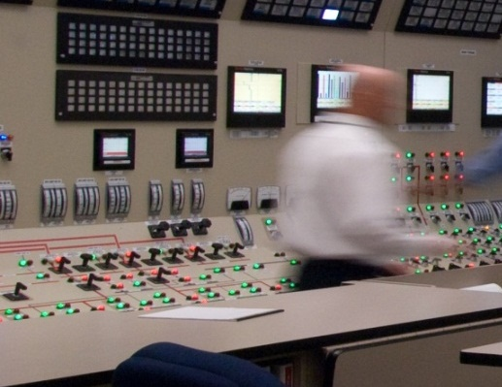
Parts of this Course
Effects of Stress
Stress Training
Decision Making Under Crisis
Crisis Leadership
Notes:
This course has four parts:
[Read and elaborate. One sentence for each item is sufficient.]
*: Effects of Stress
*: Stress Training
*: Decision Making Under Crisis
*: Crisis Leadership
By the time we cover this material, you will have new ideas to apply to the Practical Exercise..

Slide 6
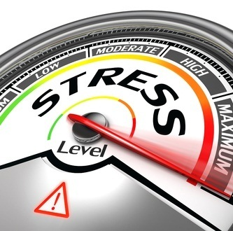
What to Expect
Get ready for:
Experiential learning
Getting out of your comfort zone
Discussing your responses to stress
Notes:
To talk effectively about stress, you will have to experience it.
Get ready for:
*: Experiential learning
*: Getting out of your comfort zone
*: Discussing your responses to stress

Slide 7
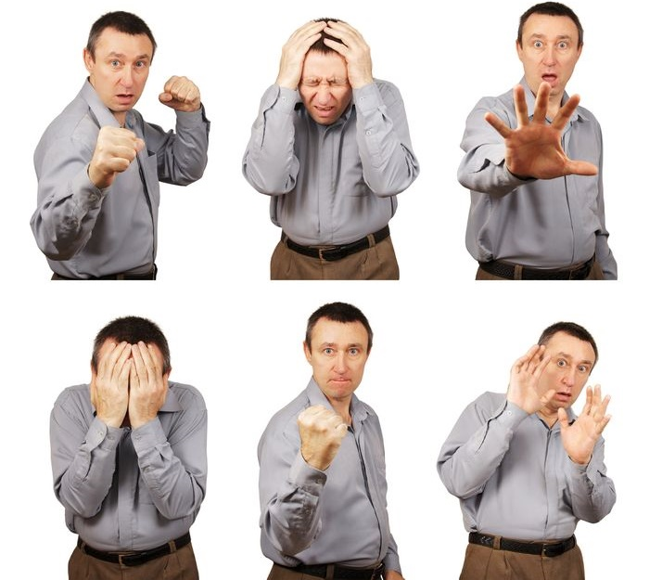
Notes:
In this course, we are going to talk about emotions.
That is an unusual topic for nuclear training, but you can’t prepare for a crisis without considering emotions.
Every person has them, and every crisis brings them out.
Leading in a crisis means controlling your own emotions, and also working with emotional people.
It is not our intention to push anyone to the breaking point, or dig into stress in your personal life.
Please take care of yourselves during this session, and respect other people’s responses and needs for privacy.
[Optional: Tell a story about your experience in a crisis, as a way to break the ice with the participants.]

Slide 8
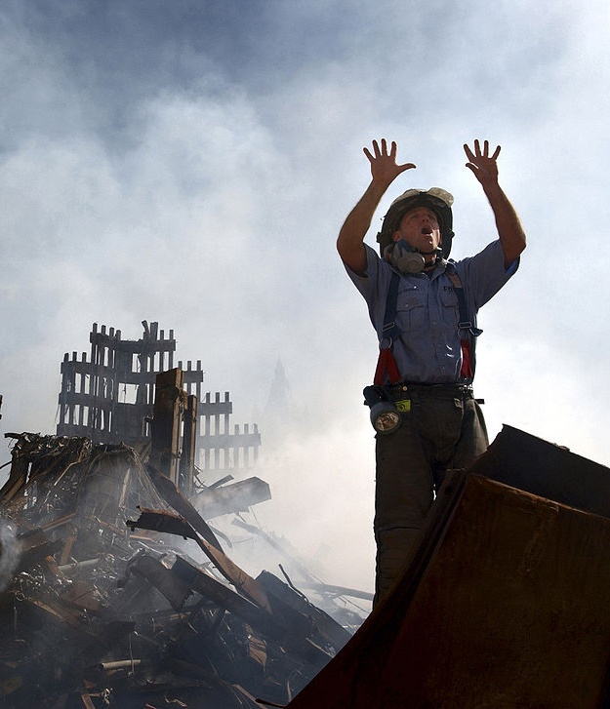
Will You Be Ready?
What will you do?
How will you react?
Source: Wikimedia, U.S. Navy Photo
HANDOUT 2: Action Plan
Notes:
A crisis is a beyond-design-basis event in which the environment is volatile, uncertain, complex and ambiguous.
It is an event we can’t fully foresee or prepare for.
What will you do when something unexpected happens? How will you react?
The nuclear power industry has a unique responsibility to protect the health and safety of the public.
You are in this course to get ready to uphold that responsibility, even in the worst conditions.
And if you don’t think it will happen to you, consider that nobody thinks it will happen to them.
The people at Fukushima Daiichi were people just like you.
None of us can afford to be unprepared for a crisis.
[Distribute HANDOUT 2: Action Plan, and encourage participants to add items to it throughout the course.]

Slide 9
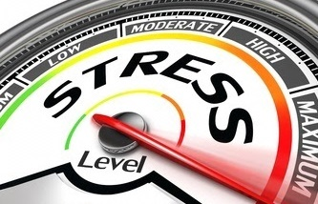
Effects of Stress
HANDOUT 3: Stress Response Checklist
Notes:
[TRANSITION SLIDE – NEW SECTION]
We will begin with stress: what it is and how it affects us.
Every person has an individual stress response. Your stress response is your reaction to the demands placed on you. Each of you will identify your stress response, with this checklist as a guide.
[Instruct participants to view the Stress Response Checklist handout.]
[Optional: Provide extra copies so that participants may use separate checklists for various activities, as desired.]
[Briefly introduce the Stress Response Checklist. Call attention to: “Physical” and “Cognitive” columns;
“NEGATIVE” and “POSITIVE” sections.]
[Instruct participants to work individually to check off the stress symptoms they experienced during the exercise, or during other stressful events. Allow about 1 minute.]
[NOTE: Remember that the checklist is personal. Do not pressure anyone to share. Share your own experiences to help participants open up. ]
?: Who will tell us what they checked off in the “Physical Symptoms” column?
[Start with your own examples, e.g., “For example, whenever I am standing up in front of a group like this, my mouth gets dry.”]
=: A variety of different symptoms; each person has a different response to stress. These responses might even be opposite to each other, e.g., one person is scattered, and another is focused.
=: Both positive and negative symptoms. Point out that sometimes stress is good.
=: If a participant didn’t experience stress during the exercise, ask them to think about other stressful situations from the past.
=: Note any cognitive symptoms that would make it difficult to think clearly or make decisions, for later discussion.
[If participants are filling out multiple Stress Response Checklists, ask them to write “Exercise 1” at the top of the checklist they just filled out.]
Later, we will refer back to these observations as a baseline. You will return to the Practical Exercise at the end of this course with a new awareness of your stress response.

Slide 10

Definition of Stress
The perception that success in meeting the demand is important
The perception that I must be the person to fulfill the demand
The perception that the demand exceeds my abilities
Is it important?
Am I required to do it?
Can I handle it?
Notes:
When we say “stress” we are typically talking about negative stress.
We know what stress feels like, but what is it, really?
We are going to use a scientific definition so that we can talk about it in precise terms.
Negative stress occurs in the presence of three conditions:
*: The perception that success in meeting the demand is important.
*: The perception that I must be the person to fulfill the demand.
In other words: Am I required to do it?
*: The perception that the demand exceeds my abilities.
In other words: Can I handle it?
?: What is the key word in this definition?
=: Perception. Stress is all about perception.

Slide 11
Negative Stress Example
There will be an examination next week.
What are my perceptions?
Is it important?
Will the score affect my
qualification?
Am I required to do it?
Do I have to take it?
Can I handle it?
Do I have to study hard in
order to pass?
Notes:
Here’s an example of how this definition applies in real life.
There will be an examination next week.
Let’s check the three criteria for negative stress.
*: Is it important? → Will the score affect my qualification?
*: Am I required to do it? → Do I have to take it?
*: Can I handle it? → Do I have to study hard in order to pass?
?: What if the answer to any one of these questions was “no”?
=: There would be no negative stress. All three are required.

Slide 12
Stress and Performance
Yerkes-Dodson Curve
Stress and Performance: The Yerkes-Dodson Curve
Exhilaration
Optimum
Performance
Difficulty remembering
Boost of
energy
Emotional
behavior
Faster
heart rate
Performance
Engagement
Impairment
Mental
focus
Can I handle it?
← YES NO →
Muscle
tension
Panic
Boredom
Exhaustion
Breakdown
Given:
Is it important? YES
Am I required to do it? YES
Demand
HANDOUT 4-A: Definition of Stress
Notes:
[Distribute HANDOUT 4-A: A Definition of Stress]
Here is another view of stress called the Yerkes-Dodson curve.
It illustrates the relationship between stress and performance.
If the first two stress criteria are true, (1) a task is important and (2) we have to do it, then performance follows a curve, based on the amount of demand.
[Read and elaborate on text:]
*: Boredom.
*: Engagement
Stress hormones produce symptoms that increase performance.
*: Optimum performance.
*: Impairment
Same stress hormones now produce symptoms that decrease performance.
*: Exhaustion
?: Where have you seen the same effect on the job?
[Be prepared to provide an example of your own.]

Slide 13
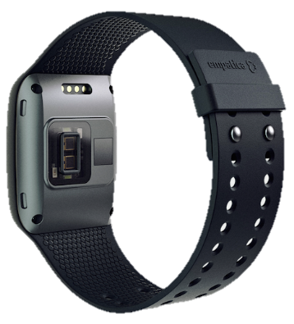
Stress Tests
Select options for your course.
Word-Color Test
Bio. Data: Full
7 Digit Test
Bio. Data: Live
Counting Test
Continue
Empatica E4 Wrist Monitor
HANDOUT 3: Stress Response Checklist
Notes:
Next we will see this curve in action.
[Refer to HANDOUT 3: Stress Response Checklist]
[Explain how you are using the wrist monitor.]
[Introduce the person who will be tested, or call for a volunteer.]
[Click buttons on left to begin stress activities as desired. You will return to this slide.]
[If desired, click a “Bio. Data …” button to explain the data while an assistant helps with the wrist monitor.]

Slide 14
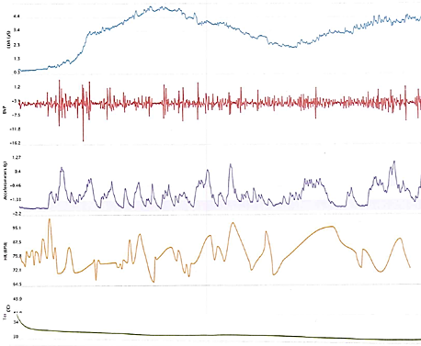
Biometric Data: Full View
Stress Activity Graphs 1
EDA=Electrodermal Activity
Indicates stimulation of the sympathetic nervous system.
BVP=Blood Volume Pulse
Indicates changes in heart rate
Accelerometer: Captures motion-based activity
HR (BPM)=Heart Rate (beats per minute)
Calculated from BVP.
Temp (°C)
HANDOUT 4-B: Empatica Wrist Monitor Data
Notes:
[Explain the biometrics as indicated on the slide.]

Slide 15
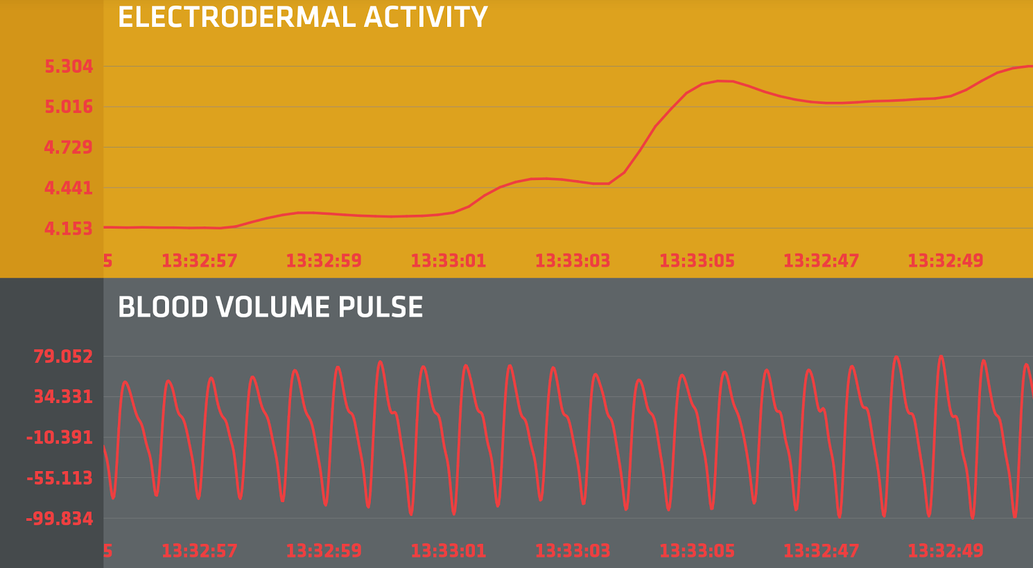
Biometric Data: Live Display
Stress Activity Graphs 2
Electrodermal Activity
Indicates stimulation of the sympathetic nervous system.
Blood Volume Pulse
Indicates changes in heart rate
Notes:
[Explain the biometrics as indicated on the slide.]

Slide 16
Stroop Word-Color Test
Stress Activity 1
Instructions:
You will see a word for one color printed in a different color.
If it appears on the left, say the color of the text.
If it appears on the right, read the word.
Five words will appear for one second each.
Say the COLOR
Read the WORD
ORANGE
BROWN
“Blue”
“Brown”
Notes:
[THIS EXERCISE IS FOR ONE PARTICIPANT ONLY.]
[Explain the instructions.]

Slide 17

EASY for TRAINING
Say the COLOR
Read the WORD
5
4
3
2
1
0
BLUE
RED
WHITE
GRAY
PURPLE
1
Notes:
PRACTICE SLIDE
[Click once to begin the sequence.]
Yellow
Blue
Brown
Green
Blue

Slide 18
EASY for TRAINING
Say the COLOR
Read the WORD
5
4
3
2
1
0
BLUE
RED
WHITE
GRAY
PURPLE
2
Notes:
PRACTICE SLIDE
[Click once to begin the sequence.]
Blue
Red
White
Gray
Purple

Slide 19
Say the COLOR
Read the WORD
5
4
3
2
1
0
BLUE
RED
WHITE
GRAY
PURPLE
3
Notes:
[Click once to begin the sequence.]
Blue
Blue
Brown
Gray
Blue

Slide 20
Say the COLOR
Read the WORD
5
4
3
2
1
0
ORANGE
BROWN
GREEN
GREEN
PURPLE
4
Notes:
[Click once to begin the sequence.]
Blue
White
Brown
Purple
Green

Slide 21
Say the COLOR
Read the WORD
5
4
3
2
1
0
RED
BROWN
GREEN
GRAY
YELLOW
5
Notes:
[Click once to begin the sequence.]
Red
Brown
Red
Gray
Purple

Slide 22
Say the COLOR
Read the WORD
5
4
3
2
1
0
BLUE
BLUE
ORANGE
BROWN
GREEN
6
Notes:
[Click once to begin the sequence.]
Red
Purple
Yellow
Brown
White

Slide 23
7 Digit Test
Stress Activity 2
Instructions:
You will see sets of seven digits on the screen for a few seconds at a time.
When your name is called, read each digit with 7 added to it (mod 10).
Example: 5901479 → 2678146
Adapted from Thinking Fast and Slow by Daniel Kahneman
Notes:
[THIS IS A GROUP EXERCISE]

Slide 24
Stress Activity 2
4723697
7361394
1539802
3764925
9423261
2189360
4673803
9305187
8710642
3689157
Notes:
[For each click, call out a person’s name.
If they pause, interrupt them and move on.
Call a person twice so that no one assumes they are “off the hook.”]
[Answer Key:]
4723697 : 1490364
1539802 : 8206579
8710642 : 5487319
4673803 : 1340570
7361394 : 4038061
9305187 : 6072854
2189360 : 9856037
3764925 : 0431692
9423261 : 6190938

Slide 25
Counting Test
Stress Activity 3
Count backwards by 13s from:
1022
:
10
09
08
07
06
05
04
03
02
01
0
00
00
Notes:
Answers to Counting Exercise: 1022, 1009, 996, 983, 970, 957, 944, 931, 918, 905, 892, 879, 866, 853, 840, 827, 814, 801, 788, 775, 762, 749, 736, 723, 710, 697, 684, 671, 658, 645, 632, 619, 606 …

Slide 26
Discussion: Your Responses to Stress
What do you feel when you perceive stress?
Discuss with partners:
  What symptoms did you experience during the last stress activities?
  What symptoms did you experience during the exercise at the beginning of the session?
  What symptoms have you experienced during stressful situations in your life?
Be sure to discuss emotional symptoms as well as physical and cognitive symptoms.
Fill out your Stress Response Checklist.
HANDOUT 3: Stress Response Checklist
Notes:
[Organize participants into groups of two or three and instruct them to discuss the questions on the slide. Allow about three minutes.]
[Instruct partners to take turns discussing the questions on the screen, and to record their personal responses to stress on the “Stress Response Checklist.” Allow discussion for about 3 minutes.]
[Remind participants that this discussion is about how they feel *during * a stressful situation, and fill out the Stress Response Checklist as they recall other stress responses.]
[Discuss the questions as a full group. Emphasize the variety of stress symptoms to make the following points:]
[Every person has a unique stress response.]
[It will help them to handle the demands of a crisis if they are aware of their stress responses.]
[It will help them to lead others if they can recognize and understand the stress responses of others.]
Now that we know what stress looks like, next we will get familiar with some tools you can use to counteract its negative effects.

Slide 27

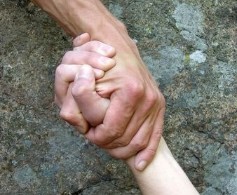
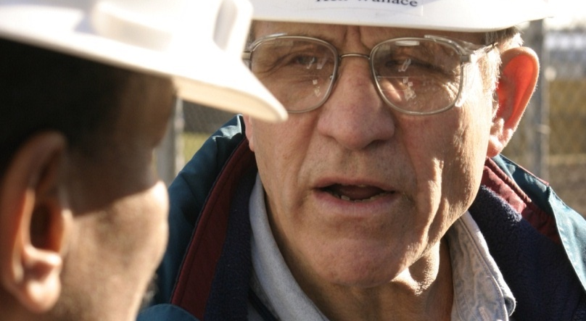
Stress Treatment
Help your team and yourself to counter the effects of stress during an emergency.
HANDOUT 5: Stress Treatment Tools
Notes:
The stress treatment tools we will discuss are not only for your own stress symptoms. You can also use them to help others. We are going to use an activity to get familiar with them quickly.
[Distribute HANDOUT 5: Stress Treatment Tools]
[Instruct participants to make note of the stress treatment tools that would help reduce the symptoms they checked on their Stress Response Checklist (Handout 3).]
[Share an experience, if possible, about a time you helped another person overcome stress using a technique described in Stress Treatment Tools, either on the job or elsewhere.]
[Begin a discussion of the Stress Treatment Tools by demonstrating the effects of breathing.]
Ask the wrist monitor volunteer to practice the slow breathing exercise, and observe the effect on the heart rate.
Ask the volunteer to breathe quickly, as if they were angry or afraid, and observe the effect on the heart rate.
Note: Do the slow breathing first, because it is typically more difficult to slow down the heart rate than to speed it up.
Emphasize that controlling breathing is the most powerful and effective stress treatment tool.
[Discuss the tools using following questions while surveying the handout:]
?: Which of these tools can help you with your own stress symptoms?
?: Which ones could you foresee recommending to others during a crisis?
?: Which ones would you never use and never recommend? (Challenge their responses: what if they encountered a colleague who could benefit?)
?: What would you say to someone who was embarrassed about their stress response during a severe situation?
?: What other tools have you used for yourself or others?

Slide 28
First-Person Account
Notes:
[FIRST-PERSON ACCOUNT: VIDEO OR GUEST SPEAKER OPPORTUNITY]
HIDE/UNHIDE these slides to customize this time.
[See Facilitator Guide for interview questions appropriate for this point in the course.]
[Unhide or replace this slide to insert video interview or guest speaker.]
[Note that 5 minutes are allotted to the proposed agenda here; 25 total for all optional remarks.]

Slide 29
Hatch Unit 1 Transformer Fire, October 2005
Browser View

Slide 30
Browns Ferry Tornadoes, April 2011 (Video 1)
Browser View

Slide 31
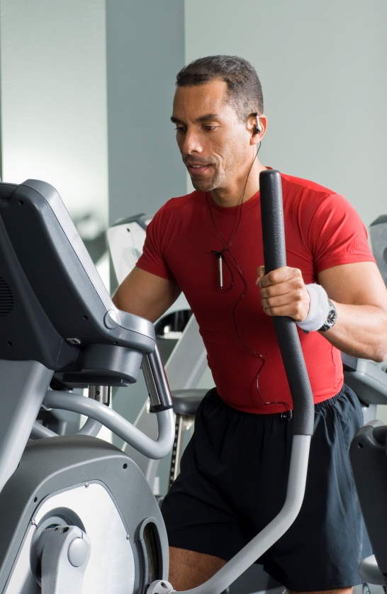
Stress Training
Getting in shape to prepare for a stressful event.
Notes:
[TRANSITION SLIDE – NEW SECTION]
There is a lot more to managing stress than just treating it when it occurs. Next we will talk about stress training methods you can use to prepare your body and mind to handle extreme stress before it happens.
How many of you engage in any sort of routine training or practice to build your strength or skills?
Performing under stress works the same way. It requires training and practice.

Slide 32

Stress Training
Tolerance and Resilience
Optimum
Performance
Performance
Engagement
Impairment
Boredom
Exhaustion
Demand
Notes:
Here is the Yerkes-Dodson curve. Stress training will improve this curve in two ways.

Slide 33
Stress Training
Tolerance and Resilience
Stress Resilience:
Perform better
Performance
Stress Tolerance:
Handle more
This Group consists of objects, some invisible, to make the curve grow properly.
Demand
Notes:
It will increase your stress tolerance to help you handle more,
* It will also increase your stress resilience to help you perform better.
[Distribute HANDOUT 6: Stress Training Checklist]
The tools on this handout are for training your mind and body to manage stress before stress occurs. These are things you can do in your everyday routines that will improve your stress response.
[Encourage participants to follow along on this handout as you describe each of the stress training activities.]

Slide 34
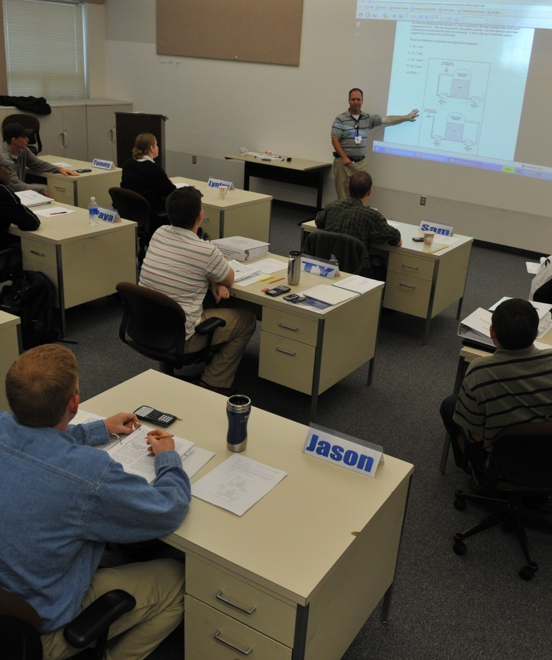
Increase Your Capacity
Stress Tolerance: Handle More
Top 3 methods for handling greater demand on the job:
Training
Training
Training
Notes:
Let’s look at ways to build stress tolerance and handle more.
?: What are the top three methods for increasing the amount of stress you can handle on the job?
*: Training,
*: Training, and
*: Training.
Developing our base of skills and experience is like doing reps in the gym to build muscle.
It’s important that you value training, not only as skill development, but also as stress reduction.

Slide 35
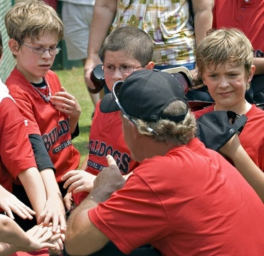

Nudge Your Comfort Zone
Stress Tolerance: Handle More
Notes:
You also get stronger by challenging yourself to push beyond your comfort zone. You can take on additional roles at work, and also outside work with activities such as sports, volunteering, or public speaking.
?: What are some other ways to nudge your comfort zone? Who has a personal experience stretching themselves?
=: Listen for answers from the participants’ personal experiences.

Slide 36
Conserve Your Stress Response
Stress Tolerance: Handle More
Stress Accumulates
Car
Trouble
BLOW UP!
Waking:
Overslept
Late for
Meeting
Performance
Negative
Feedback
at Work
Performance
Engagement
Impairment
REACTION
DANGER ZONE
Boredom
Exhaustion
Demand
Notes:
Let’s look at ways to avoid excess stress. In other words, conserve your stress hormones for issues that matter.
Stress accumulates. All the little stressors build up stress.
For example, Bud is having a bad day.
*: He oversleeps.
*: His car won’t start.
*: He’s late for an important meeting.
*: Then he receives some negative feedback on the job that he doesn’t appreciate. Now he’s in a bad mood.
*: The very next person that asks Bud a question causes him to blow up and get angry for no apparent reason.
Have you met a Bud?
None of these stressors, by itself, would send a normal person into the Danger Zone, but all together, they can do just that.

Slide 37
Conserve Your Stress Response
Stress Tolerance: Handle More
Stress Accumulates
ALARM
Routine Stressors
Performance
Performance
Engagement
Impairment
DANGER ZONE
Boredom
Exhaustion
Demand
Notes:
Ideally, we want: To keep your stress responses during the day to stay on the left side of the curve.
*: Then, when something important occurs, like an alarm in the control room, you are ready to power up, not blow out.

Slide 38

Reduce Everyday Stress
Stress Tolerance: Handle More
Stay organized:
  Finances
  Car and home
  maintenance
  Birthdays,
  anniversaries, and
  holidays
Follow a routine
Ask for help to eliminate stressful activities
Notes:
To conserve your stress response, reduce your everyday stress:
[Read and elaborate on points on the slide.]
*: Stay organized:
Finances
Car and home maintenance
Birthdays, anniversaries, and holidays
*: Follow a routine
*: Ask for help to eliminate stressful activities

Slide 39

Adjust Your Perceptions
Stress Tolerance: Handle More
Is it important?
Am I required to do it?
Can I handle it?
Is it really important?
Can I delegate it?
Could I actually handle it?
  Get help.
  Learn it.
  Manage expectations.
  Give myself credit.
Notes:
Another technique is to examine and adjust your perceptions. Remember, stress is what we perceive. Ask yourself:
*: Is it really important?
*: Can I delegate it to someone else?
*: Could I actually handle it? Could I get help? Learn it? Manage expectations? Or give myself more credit for what I can do?

Slide 40

Plan Ahead with Your Family
Stress Tolerance: Handle More
Notes:
In a crisis situation, you will reduce your stress if you know that your family has a plan. Work out in advance several different ways for your loved ones to communicate with you and take care of themselves if you are on shift when something happens.
[End of STRESS TOLERANCE portion of the LECTURE]

Slide 41

Focus the Mind
Stress Resilience: Perform Better
Best way to build resilience
Requires practice to master
Notes:
Now let’s look at ways to build resilience and perform better.
The best way to build resilience is to gain control over your mind so that you can avoid stressful thinking.
Learning to focus the mind builds and strengthens the areas of the brain that can be weakened by stress hormones.
During a crisis, it will be vitally important for you to focus on your responsibilities and keep your emotions in check.
But the ability to do this does not come automatically—it requires practice before the crisis hits.
[OPTIONAL MINDFULNESS EXERCISE]
Say: Just as you exercise your body to develop physical resiliency, you can exercise your mind to develop mental resiliency. Exercising your mind begins with mindfulness. Mindfulness is simply situational awareness of your own mind. The military is using mindfulness training to prepare soldiers for combat, and scientists are finding that mindfulness training actually changes the brain in ways that reduce the stress response. We are going to practice this together.
Do: Instruct participants through the following steps. Note that the pauses of 20 to 30 seconds should be long enough to feel uncomfortable.
Please remain silent throughout this exercise.
Get out a piece of paper and pen or pencil.
Think of something outside this classroom that has been bothering you, such as an issue you are worried about, or a task you’re not looking forward to. Write it down on this sheet of paper. (Pause until completed.)
Fold the paper twice so that you can’t see what you have written. Keep the paper in front of you.
As we continue with this exercise, if your mind wanders back to that thought, just set it aside and bring your attention back to this exercise.
Select one object near you and notice everything about it—the shape, color, texture, material it’s made from, any other identifying characteristics. Keep your attention here. (30 seconds)
Listen to the sounds in this room. Notice the white noise and any other sounds we tend not to notice. Keep your attention here. (20 seconds)
Pay attention to physical sensations, such as the feeling of the chair you’re sitting in, your clothes, your shoes, and any sensations such as thirst or stiffness. Keep your attention here. (20 seconds)
Leave that piece of paper closed and folded up. For the rest of the this session, when you find yourself thinking about that issue, actively let that thought go, and bring your entire focus back to what you are doing here and now.
[Follow with discussion]

Slide 42

Focus the Mind
Stress Resilience: Perform Better
Singletask.
Write lists.
Reduce distractions.
Minimize clutter.
Use technology.
Listen to others.
Notes:
Here are some (other) ways you can practice focusing your mind:
[Read and elaborate.]
*: Singletask.
*: Write lists.
*: Reduce distractions.
*: Minimize clutter.
*: Use technology.
*: Listen to others.

Slide 43
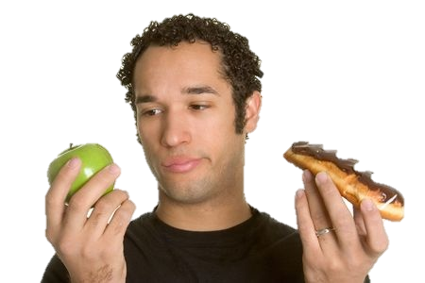
Practice Self-Regulation
Stress Resilience: Perform Better
Do what’s right, not just what’s easy.
Do the hardest thing first.
Notes:
Self-regulation is the ability to think before acting, and keep emotions and impulses in check. Self-regulation can keep you in control during a crisis. This means (one click per bullet):
*: Doing what is right, not just what is easy.
*: Do the hardest thing first.
Practice self-regulation daily, and you will have it when you need it in a crisis.

Slide 44


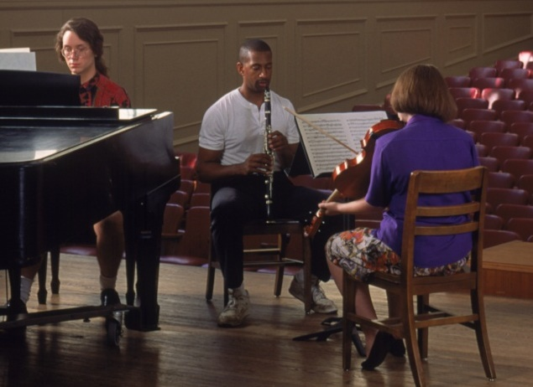

Resilience Tools
Stress Resilience: Perform Better
Build your support network.
Cultivate a positive attitude.
Be a life-long learner.
Value your health.
Notes:
Here are some other tools to help you to build resilience:
[Read and elaborate.]
*: Build Your Support Network
*: Cultivate a Positive Attitude
*: Be a Life-long Learner
*: Value your health
[End of STRESS RESILIENCE portion of the LECTURE]

Slide 45
Discussion: Stress Training
Partner discussion questions:
Which tools are already in your lifestyle?
  What effects have you seen?
Which of these tools can you start using?
  What small changes can you make to get started?
What other activities or practices help you prepare to perform under stress?
HANDOUT 2: Action Plan
HANDOUT 3: Stress Training Checklist
Notes:
[Refer to HANDOUTS 2, Action Plan, and 6, Stress Training Checklist.]
[Organize participants into groups of two or three and instruct them to discuss the questions on the slide. Allow about three minutes.]
[Remind participants to:]
[Commit to small, doable changes.]
[Use stress training to address the symptoms on their Stress Response Checklist.]
[Discuss the questions as a full group.]
[In addition:]
?: What is your biggest takeaway from the discussion about tolerance and resilience?
?: How can these tools help make you a better leader overall?
[Give participants a moment to add to their Action Plan (Handout 2) based on this discussion.]
That concludes our formal discussion about stress, but you will apply what you know about stress throughout the rest of the course.

Slide 46
First-Person Account
Notes:
[FIRST-PERSON ACCOUNT: VIDEO OR GUEST SPEAKER OPPORTUNITY]
[See Facilitator Guide for interview questions appropriate for this point in the course.]
[Unhide or replace this slide to insert video interview or guest speaker.]
[Note that 5 minutes are allotted to the proposed agenda here; 25 total for all optional remarks.]

Slide 47
Browns Ferry Tornadoes, April 2011 (Video 2)
Browser View

Slide 48
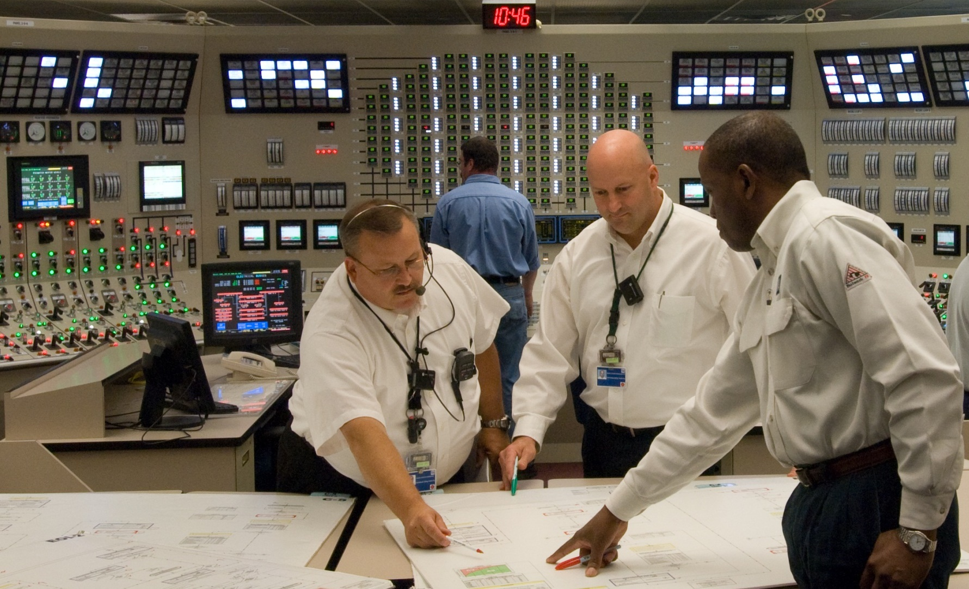
Decision Making Under Crisis
Notes:
TRANSITION SLIDE – NEW SECTION
Next, we’re going to apply what we know about stress to the process of making decisions in a crisis.
?: Given what we know about stress and its effects on our brains, how do you think stress can affect our ability to make decisions?
=: Perceive new information selectively, and perhaps miss something important.
=: Feel rushed and take shortcuts.
=: Have difficulty concentrating and focusing.
=: Get tunnel vision.
=: Succumb to “groupthink.”
=: Experience emotions that lead to conflict.
Stress makes it harder to make decisions, just when we need our decision-making abilities the most. There are ways to support good decision making, even under stress.

Slide 49
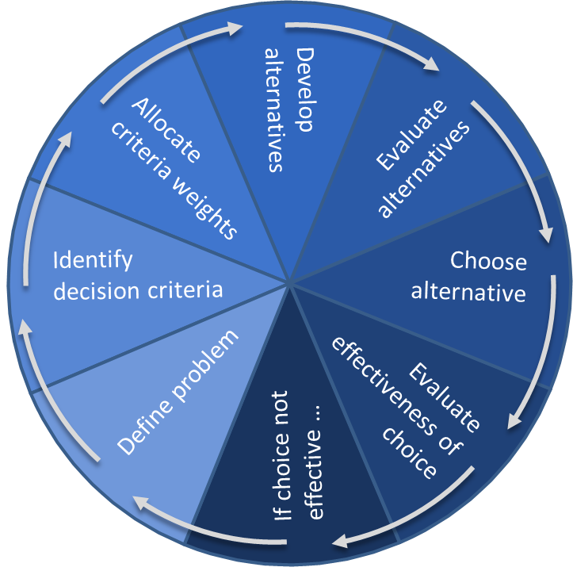
Traditional Decision-Making Model
Situation
Perception: Will I respond?
No
END
Yes
Act
Is response automatic?
Skills
Yes
intuitive
Very high reliability
No
Is the situation recognizable?
Apply Rules
or Procedures
Rules
High reliability
Yes
No
Develop Situational Awareness
Make Rational
Decision
Knowledge
Moderate reliability
rational
Source: Adapted from the GEMS model as illustrated in Human Error by James Reason. Based on the work of Jens Rasmussen.
HANDOUT 7-A
Notes:
To understand how to make better decisions in a crisis, let’s look at two decision-making models: one that is used traditionally, and one that applies to crisis conditions. This is the traditional model.
This model is based on the skills-rules-knowledge (or SRK) model that you have seen in relation to error control.
[Refer to HANDOUT 7-A: Decision Making: A Traditional View]
[Walk through the diagram on each of the three levels. For each level point out:
Reliability (Very high, high, moderate)
Place on the Intuitive vs. Rational scale
Provided examples
Examples from participants.]

Slide 50
The Decision-Making Challenge
In a crisis, at what level can we make decisions?
intuitive
Skills
Very high reliability
Here?
Rules
High reliability
Or here?
Knowledge
Moderate reliability
rational
Notes:
?: Where do crisis decisions fall on the S-R-K model?
=: any answer; during a crisis, there are benefits of both rational and intuitive decision making.
[Point out that there are benefits to each approach.]
Let’s look at both rational and intuitive methods.

Slide 51
Rational Decision Making
Notes:
There are many methods for making a rational decision, especially with a team. The method illustrated here is typical.
?: What are the benefits of this method? Why would you want to use this method in a crisis?
=: To overcome stress
=: Avoid overlooking good options
=: Arrive at the best possible decision among all the options
=: Be able to justify the decision later
?: What are the drawbacks and risks of this process during a crisis?
=: Time-consuming
=: Lends itself to getting stuck
=: Requires complete and accurate information
=: Not tolerant of volatility and ambiguity
=: Less reliable than intuitive decision making

Slide 52
Intuitive Decision Making
Course of Action
Notes:
In contrast, let’s look at intuitive decision making. This is the kind of decision where people get an idea in a flash, and they are very confident they are right. Sometimes they don’t even know why.
?: Has this happened to you? Or have you watched others decide and act intuitively?
?: What are the benefits?
=: Faster
=: More reliable (if the skill or rule is properly matched to the situation)
?: What are the drawbacks and risks?
=: You can’t always defend the logic
=: No one can test it
=: There is no teamwork; it is one person’s opinion

Slide 53
How First Responders Decide
With the benefit of experience, expert decision makers operate here:
intuitive
Skills
Very high reliability
Rules
High reliability
Knowledge
Moderate reliability
rational
Notes:
Researchers observed wildfire firefighters and discovered that they take advantage of both rules and knowledge when they are under pressure in a dangerous situation.
[Throughout this lecture, stress that recognition-primed decision making is the natural way that experienced people apply their experience. This is a process they already use, and should be aware of.]

Slide 54
Recognition-Primed Decision Making
on the Skills-Rules-Knowledge Performance Model
Situation
Perception: Will I respond?
No
END
Yes
Act
Is response automatic?
Skills
Yes
No
Course of Action
Is the situation recognizable?
2
Course of Action
Yes
Rules
Now it is
Not yet
1
Sensemaking
Recognizing
Make sense?
Framing
3
Mental Simulation
Yes
5
Questioning
Will it work?
Knowledge
4
Questioning
No
Sources: Adapted from Reason and Rasmussen as above,
and the Recognition-Primed Decision Making model as illustrated in Sources of Power by Gary Klein (1998), and A Model of Sensemaking by Klein Associates (2007).
HANDOUT 7-B
Notes:
The technique is called “recognition-primed decision making” because it relies on the decision maker’s ability to recognize patterns and cues.
[Walk through the diagram at a high level using the numbered steps.]
[Refer to HANDOUT 7-B: Recognition-Primed Decision Making]
[Note: Shortly, you will explain Sensemaking, Mental Simulation, and Questioning in more detail.]
It’s important to remember that this is the way people under pressure actually make decisions.
It is not a technique you have to learn—you already use it.

Slide 55
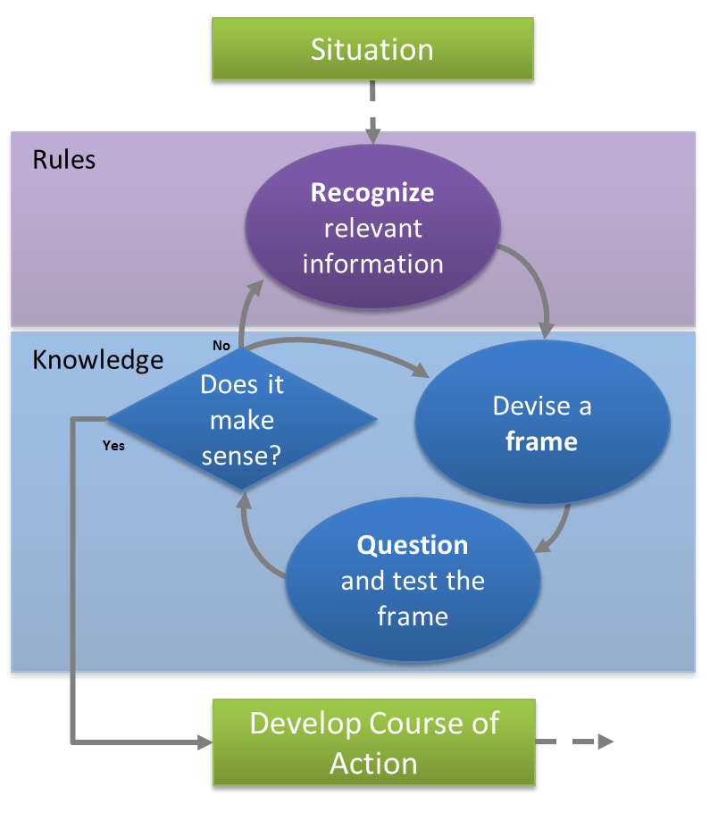
Sensemaking
Recognize
Frame
Question
Repeat until the situation makes sense.
HANDOUT 7-B
Notes:
Sensemaking is a process of its own, and it has been gaining the attention of the military, first-responder organizations, and business schools.
It is the process of collecting and sorting out new information to develop situational awareness.
[Walk through the steps in the diagram.]
[Refer to HANDOUT 7-B: Recognition-Primed Decision Making]
[Point out that the recognize step is on the rules level, relying on pattern recognition and intuition.]
[You will cover questioning in more detail shortly.]

Slide 56
How the Decision Emerges
Intuitively
Spontaneously
“Good Enough”
Course of Action
Course of Action
Notes:
Once a decision maker has made sense of a situation, a course of action usually comes to mind …
*: intuitively and spontaneously. It’s important to note that these fast, intuitive decisions are not optimized or proven.
*: They are just good enough to get the job done.
In a crisis, you probably won’t have all the facts at your disposal anyway, so a “good enough” decision might be the best you can do.
It is usually better to take action with a “good enough” course of action than it is to wait.

Slide 57
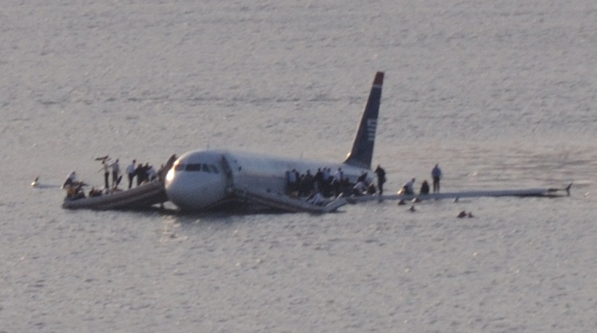
Miracle on the Hudson
A case study of recognition-primed decision making
US Airways Flight 1549 after its emergency landing in the Hudson River, January 15, 2009.
Photo credit: Wikimedia https://commons.wikimedia.org/wiki/File:Plane_crash_into_Hudson_River.jpg
Video: https://www.youtube.com/watch?v=5SL1A2d2e7M&t=10m00s
YouTube Video
Notes:
Let’s look at example: US Airways Flight 1549, which landed in the Hudson River just a few minutes after takeoff, after birds had flown into both engines.
As this video begins, pilots in a simulator are going through the timeline of the event, starting when the engines have failed.
[Start video by clicking button in lower right. The video will automatically begin at 10:00.
[If needed, use this URL: https://www.youtube.com/watch?v=5SL1A2d2e7M&t=10m00s ]
[End at approximately 13:30 after Sullenberger says: “…was the river.”]
?: How did Sullenberger apply the models we just discussed?
=: They used sensemaking to gain situational awareness and clarify their options.
=: Sullenberger used recognition-primed decision making to identify the river as the only place he could land.
[If desired, walk through the Recognition-Primed Decision Making diagram (Handout 7–B) while discussing Sullenberger’s course of action.]

Slide 58

Mental Simulation
How to implement
What to expect
What surprises to look for
The possible outcomes
Notes:
Once Sullenberger chose the river to land on, he was certainly going through a simulation of the landing in his mind, so that he would be ready to perform.
Decision makers naturally create a simulation of the course of action in their minds, going over:
*: How to implement the course of action
*: What to expect
*: What surprises to look for
*: The possible outcomes
?: What mental simulations have you run when making a decision?

Slide 59
Questioning
Seek | Avoid
Facts | Wishful Thinking
Experience | Overconfidence
Perspective | Bias
Possible Outcomes | Getting Stuck
Challenges | Groupthink
Positive Stress | Negative Stress
HANDOUT 8 – A: Questioning to Support Decision Making
Notes:
Both the sensemaking and decision-making models have a step for questioning. This is where you check and test your thinking, when you have time. Preferably, you will have a peer or a team to help you.
[Refer to HANDOUT 8-A: Questioning to Support Decision Making.]
[Walk through the checks listed.]
Note that the questioning step is meant to be rapid, even if other people are involved.
Be careful of the items in the “Avoid” column, which can bog you down or cloud your judgment.
[Instruct participants to read the HANDOUT 8-B: Thinking Traps to Avoid on their own.]

Slide 60

Your Recognition-Primed Decisions
When have you made a recognition-primed decision on the job?
Notes:
?: When have you made a recognition-primed decision on the job?
[Prepare an example of your own.]

Slide 61
Prime Your Intuition
Top 3 methods for improving your intuition:
Training
Training
Training
Notes:
?: What are the top three methods for improving your intuition?
*: Training,
*: Training, and
*: Training.
?: Why is this?
=: Training makes more situations recognizable, so that your decisions can occur in rules space or even skills space.

Slide 62
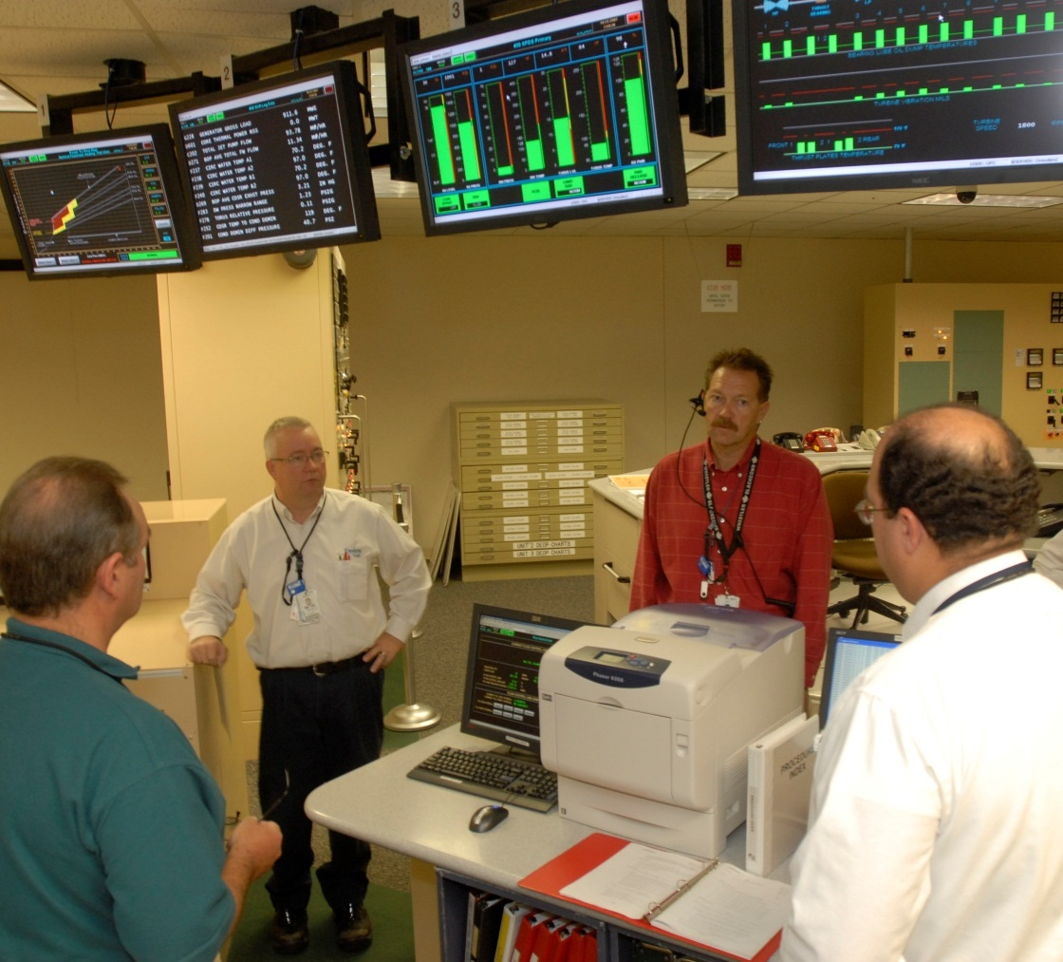
Prime Your Intuition
Other ways to increase your intuitive abilities?
Practice “What If.”
Seek out new experiences.
Follow-up on feedback.
Know your people.
Know the OE.
HANDOUT 2: Action Plan
Notes:
Here are some ways you can grow your base of experience and improve your intuition:
[Read and elaborate.]
*: Practice “What If.”
*: Seek out new experiences.
*: Follow-up on feedback.
*: Know your people.
*: Know the OE.
[Instruct participants to review their Action Plan and make notes of the ways they can improve their experience and intuition.]
[END OF DECISION MAKING LECTURE]

Slide 63
First-Person Account
Notes:
[FIRST-PERSON ACCOUNT: VIDEO OR GUEST SPEAKER OPPORTUNITY]
[See Facilitator Guide for interview questions appropriate for this point in the course.]
[Unhide or replace this slide to insert video interview or guest speaker.]
[Note that 5 minutes are allotted to the proposed agenda here; 25 total for all optional remarks.]

Slide 64
Fort Calhoun Flooding,
June 2011
Browser View

Slide 65
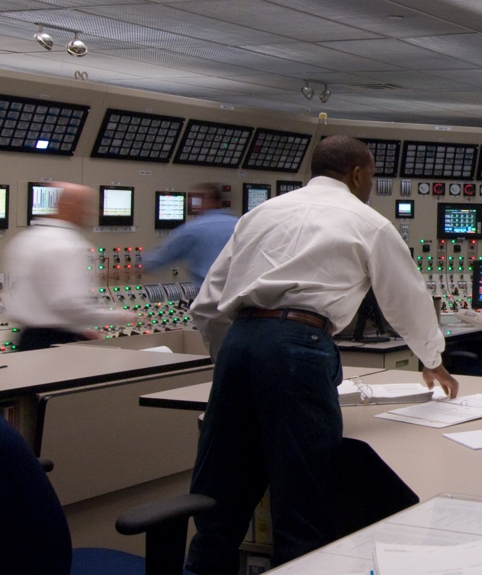
Crisis Leadership
Crisis leadership is different.
Effective crisis leaders must:
Lead in resistance to stress.
Lead in the face of volatility.
Lead with effective communication.
Lead with priorities and values.
Lead without criticism.
HANDOUT 9: Crisis Leadership Tools
Notes:
[TRANSITION SLIDE – NEW SECTION]
We will see how to apply the stress tools and decision-making methods we have covered so far as we talk about crisis leadership.
The leadership skills required in a crisis are different from those required in your daily work.
Because everything is new in a crisis, leaders must be ready to:
[Read and elaborate.]
*: Lead in resistance to stress.
*: Lead in the face of volatility.
*: Lead with effective communication.
*: Lead with priorities and values.
*: Lead without criticism.
[Instruct participants to review the Crisis Leadership Tools in preparation for the next activity.]
[Optional: Walk through the checklist.]

Slide 66
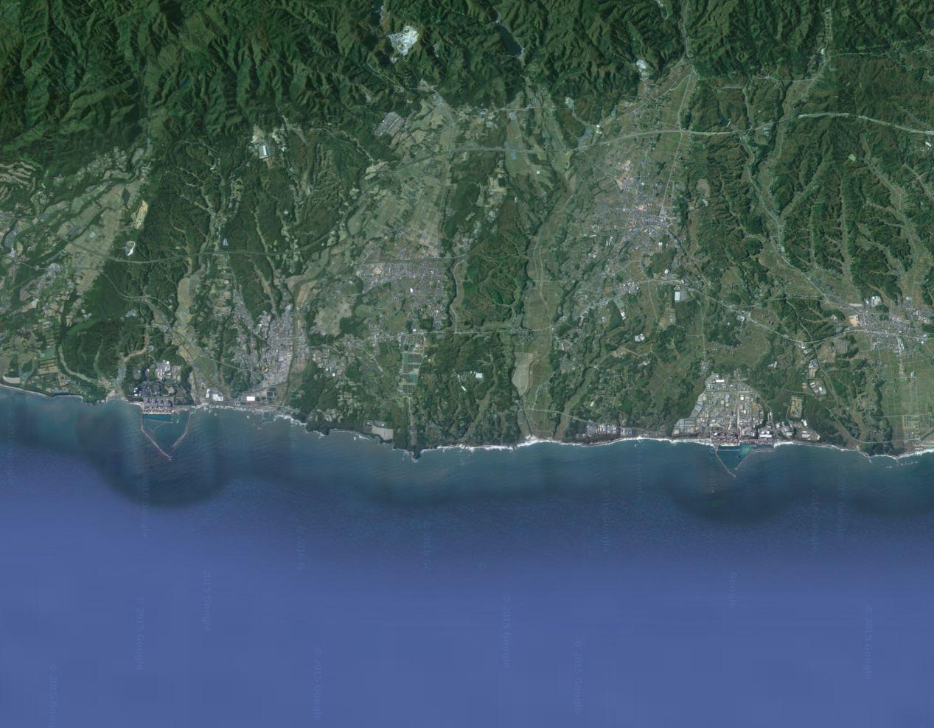
Crisis Leadership Case
Study: Fukushima Daini
11.7 km / 7.27 miles
FUKUSHIMA
DAINI
FUKUSHIMA
DAIICHI
Source: Google Maps
HANDOUT 10: Case Study Worksheet
Notes:
[Use Case Study Worksheet to guide participants through this exercise.]

Slide 67
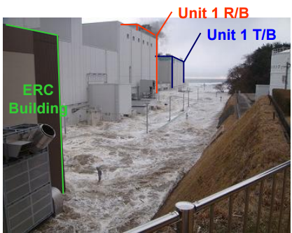
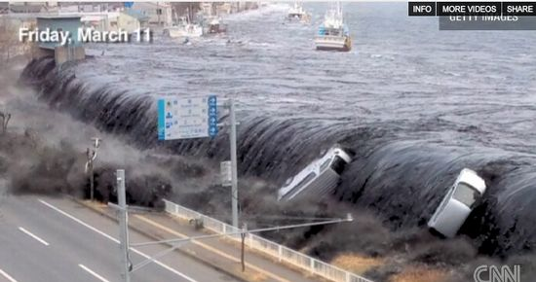
Situation 1. Set Direction
Earthquake and tsunami hit.
Aftershocks continue.
People are afraid.
Walkdowns are needed.
How will you convince them to go?
Notes:
Friday evening, after the earthquake and two-hour tsunami, a tsunami alert remains in effect, and aftershocks continue.
Night has fallen and most of the station has lost power.
The property is flooded and strewn with debris, and there is risk of radiation exposure outside.
People are afraid to leave the emergency response center.
However, the logical next step is to direct members of the staff to perform walkdowns and damage assessments on all four units.
How will you convince them to go?

Slide 68
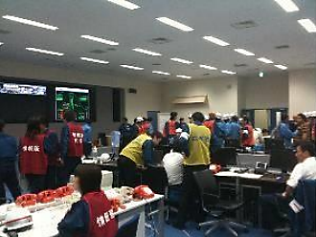
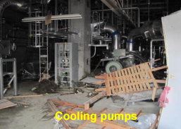
Situation 2. Maximize Competence
Three of four units need power for heat removal, and only one off-site power source remains.
Crews must wind 5.5 miles of cable into 200-yard, 1-ton lengths.
They must accomplish this is one day.
How will you communicate this plan to your team?
Notes:
Assessment teams agree to go on walkdowns.
By 02:00 Saturday, teams report that Units 1, 2, and 4 have lost key cooling.
Two of three EDGs are operational at Unit 3.
Only one operable off-site power source remains.
You and your plant leaders develop a highly ambitious plan, requiring your staff to wind 5.5 miles of cable into 200-yard, 1-ton lengths.
They will have to do in one day what would normally be accomplished in a month.
How will you communicate this plan to your team?

Slide 69
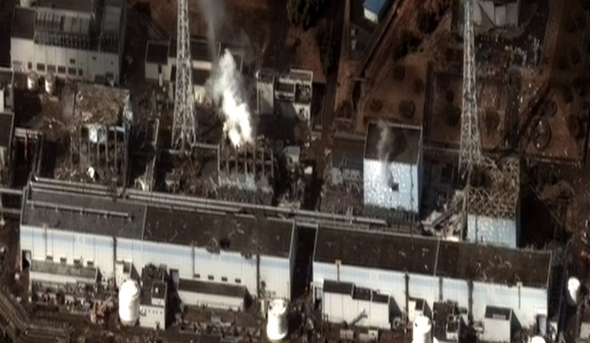
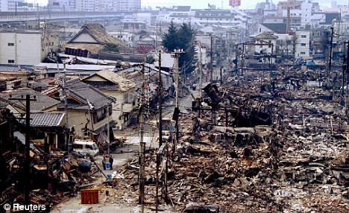
Situation 3. Engage the Workforce
Crews are reaching exhaustion.
Daiichi Unit 1 has exploded.
Families of 80% of staff are evacuated.
Loved ones are homeless, injured, or even dead.
How will you maintain trust and keep people motivated to do this critical work?
Daiichi photo: Digital Globe via Wikimedia
Notes:
After more than 24 hours under stress, without sleep, and with limited food and water, crews are winding and laying heavy cable using mostly their own physical strength.
At 15:36 on Saturday, March 12, an explosion occurs at Unit 1 at Fukushima Daiichi.
Evacuations are ordered within a 20km radius of Daiichi, which includes homes of 80% of the Daini staff.
Staff members are starting to receive news—some of it very bad—about the safety of their families and homes.
How will you maintain trust and keep people motivated to do this critical work?

Slide 70
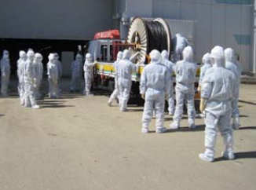
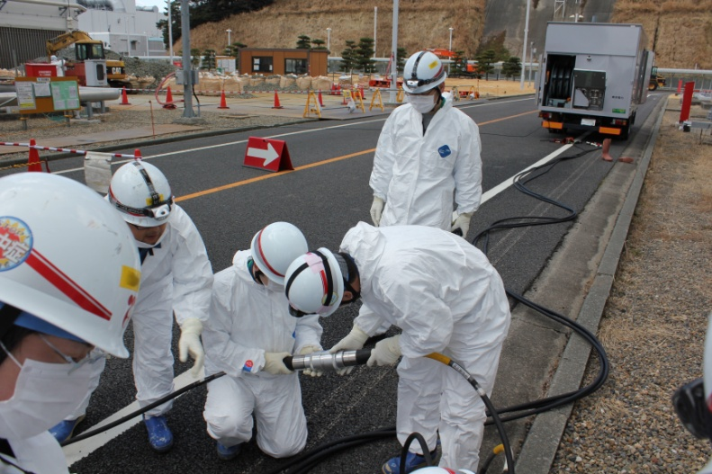
Situation 4. Cope with Risk
Time is running out to run the cable all the way from the radwaste building.
You will have to change course and use the generators in Unit 3.
How will you engage diverse perspectives to inform your decision while ordering a major change to the plan?
Notes:
By early morning on Sunday, it becomes clear that there is not enough time to lay the cable from the radwaste building to Unit 2, which is highest priority, and to Unit 4, which is most remote.
Despite some risks, you must use the generators in Unit 3 as a power source for the other units.
How will you engage diverse perspectives to inform your decision while ordering a major change to the plan?

Slide 71
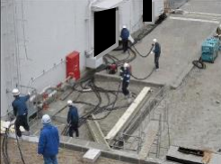
Situation 5. Achieve Sustainable Results
Pressure is rising in Unit 1, requiring immediate action.
Work at Unit 2 is wasted.
Danger is increasing.
How will you keep people focused on their tasks as their physical energy wanes and their personal risk increases?
Notes:
Sunday evening, time is getting short.
What’s more, pressure begins rising unexpectedly in Unit 1, making it the higher priority over Unit 2.
It is a matter of hours before Unit 1 will exceed its maximum pressure threshold.
Some of the painstaking work at Unit 2 is wasted.
The risk of danger to the staff is increasing.
How will you keep people focused on their tasks as their physical energy wanes and their personal risk increases?

Slide 72
First-Person Account
Notes:
[FIRST-PERSON ACCOUNT: VIDEO OR GUEST SPEAKER OPPORTUNITY]
[See Facilitator Guide for interview questions appropriate for this point in the course.]
[Unhide or replace this slide to insert video interview or guest speaker.]
[Note that 5 minutes are allotted to the proposed agenda here; 25 total for all optional remarks.]

Slide 73
Fukushima Daiichi Earthquake and Tsunami, March 2011
Browser View

Slide 74
Fort Calhoun Flooding,
June 2011
Browser View

Slide 75
Crisis Leadership
Crisis leadership is different.
Effective crisis leaders must:
Lead in resistance to stress.
Lead in the face of volatility.
Lead with effective communication.
Lead with priorities and values.
Lead without criticism.
HANDOUT 2: Action Plan
HANDOUT 9: Crisis Leadership Tools
Notes:
[Instruct participants to review their Action Plan and the Crisis Leadership Job Aid and make notes of leadership approaches to practice.]

Slide 76
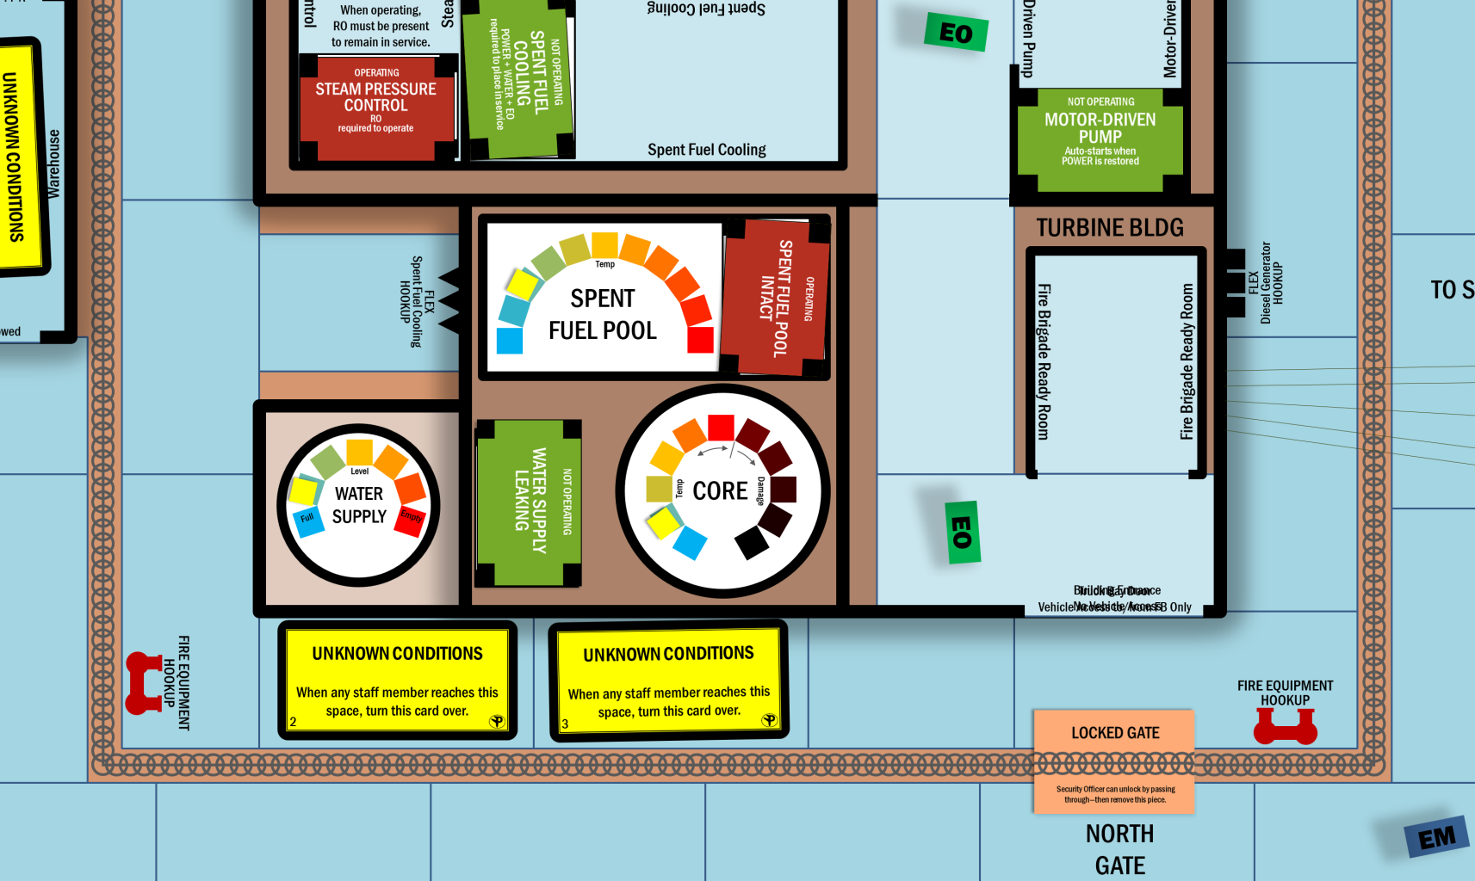
Return to Three Pillars
Notes:
It’s time to remember everything you have learned, and apply it to the Three Pillars Nuclear Power Plant.
Let’s review what we’ve covered in this course so far:
- Effects of stress, and ways to treat them during a crisis.
- Tools for preparing to handle stress better and increase performance under stress.
- The decision-making process that people actually use under crisis conditions, and ways you can get better at it.
Specific approaches to leadership during a crisis.
[Write responses from the following discussion on flip chart paper or other media that can be displayed in the practical exercise area. ]
[Be sure that the answers cover the stress, decision-making, and crisis leadership topics.]
?: We are about to return to the practical exercise. Given what you’ve learned today, what can you and your teams do differently as you return to Three Pillars?
=: Pay attention to our stress responses; notice our symptoms and regulate them.
=: Slow down and breathe if we feel stress.
=: Keep attention focused.
=: Apply sensemaking when we receive new information.
=: Trust our intuition for making decisions; but also check that our decisions are based on facts, not biases.
=: Anticipate volatility and frequent change.
=: Use 3-way communication.
=: Conduct more briefs.
=: Listen carefully to one another.

Slide 77
Practical Exercise
Part 2
Notes:
[Display this slide while conducting Practical Exercise Part 2 and the After-Action Review.]
[Bring the list of responses from the discussion and display it in the practical exercise area.]

Slide 78
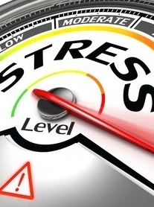
Compare Your Stress Responses
What was your stress response?
How will your awareness of stress help?
How will stress treatment tools help?
Notes:
[Instruct participants to pull out their Stress Response Checklist (Handout 3). If participants filled out multiple lists, ask them to look at the one marked “Exercise 1,” from the Practical Exercise, Part 1.]
?: Did you experience any of the same stress responses?
=: similarities and differences that will lead into the next questions.
?: How did your awareness of your stress response change your experience of stress? Or how do you think it will help in a real crisis?
?: How did your awareness of stress treatment tools change your experience of stress? Or how do you think it will help in a real crisis?

Slide 79
Will You Be Ready?
What will you do to get ready for the unexpected?
Source: Wikimedia, U.S. Navy Photo
HANDOUT 2: Action Plan
Video: Browser View
Notes:
Will you be ready?
What will you do to get ready for the unexpected?
This is a broad topic for a 4-hour course. The real training is up to you.
[Play the “Will You Be Ready?” video:
Click the “Video: Browser View” button at the bottom of the slide, or go to:
or play Will You Be Ready.mp4.]
[Give participants a few minutes, as needed, to complete HANDOUT 2: Action Plan.]
[Go around the room and ask each participant:]
?: What is one action from your Action Plan that you will take?
?: What is your biggest takeaway (the most important thing that was new)?

Slide 80
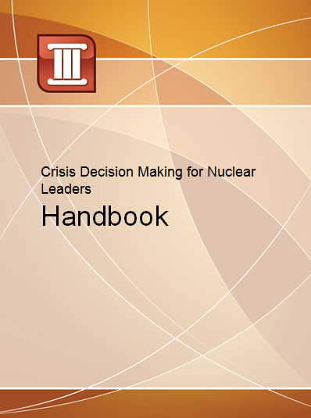
Resources
Your Handbook
contains:
Topics for further
inquiry
Recommended reading
list
Copies of all handouts and job aids
Review of all information in the course
Notes:
We’re providing a handbook that you can use for further study.
It includes:
*: Topics for further inquiry
*: Recommended reading list
*: Copies of all handouts and job aids
*: Review of all information in the course

Slide 81
Courage is not the absence of fear, but the triumph over it.
—Nelson Mandela
Notes:
Here is one final thought.
If this course was successful, then you have what you need to triumph in a crisis.
[Answer or discuss any final questions as time allows.]

Slide 82
Crisis Decision Making for Nuclear Leaders
Notes:
[END SLIDE]
[Distribute and collect evaluation forms.]
[Display and examine wrist monitor data as time allows.]

